Slide 1

LEXICAL ANALYZER
BY:
ABHI MUKESHKUMAR PATEL[RA2011026010078]
SHRESTH GUPTA[RA2011026010091]

Slide 2

ABSTRACT
The compiler is designed to support the translation of a high-level programming language into executable code, following the classic six-phase compilation process: lexical analysis, syntax analysis, semantic analysis, intermediate code generation, code optimization, and code generation.
We present the design and implementation of a compiler with all six phases using the Python programming language and the Tkinter library for creating a graphical user interface (GUI).

Slide 3
LEXICAL ANALYZER
It is also called a scanner.
It takes the output of the preprocessor (which performs file inclusion and macro expansion) as the input which is in a pure high-level language.
It reads the characters from the source program and groups them into lexemes (sequence of characters that “go together”).
Each lexeme corresponds to a token.
Tokens are defined by regular expressions which are understood by the lexical analyzer. It also removes lexical errors (e.g., erroneous characters), comments, and white space.
It is the first phase of the compiler and it is followed by the Syntax Analyzer which parses the token stream and verifies whether the program adheres to specific grammar rules

Slide 4

PROBLEM STATEMENT
Tokenization: The lexical analyzer should be able to scan the input text character by character and identify the language-specific tokens. These tokens may include keywords, identifiers, operators, literals, and punctuation symbols. Each token should be classified and categorized according to the language's lexical rule.
Handling Whitespace and Comments: The lexical analyzer should handle whitespace characters (spaces, tabs, line breaks) and comments in the source code appropriately. It should discard or ignore these elements as they do not contribute to the meaning or structure of the program.
Building Symbol Table: The lexical analyzer may be required to build and maintain a symbol table that stores information about identifiers found in the source code. It should identify and handle identifiers, such as variable names or function names, and associate them with their attributes, such as data type or scope.

Slide 5

OBJECTIVE
Understanding the role and importance of the Lexical Analyzer Phase within the Compiler
Understanding the various types of token and how Lexical Analyzer breaks a statement into tokens
Implementing lexical analysis on a simple C++ compiler and examining the output the lexical analyzer generates
The lexical analyzer maintains a symbol table that stores information about identifiers found in the source code, such as variable names or function names. It keeps track of their attributes, such as data type or scope, for later stages of the compilation process.

Slide 6
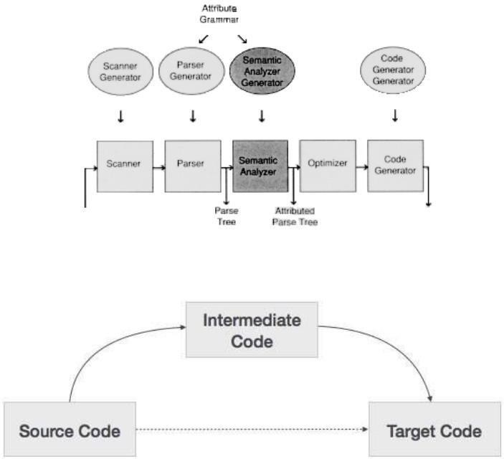
ARCHITECTURE DIAGRAM - COMPILER

Slide 7
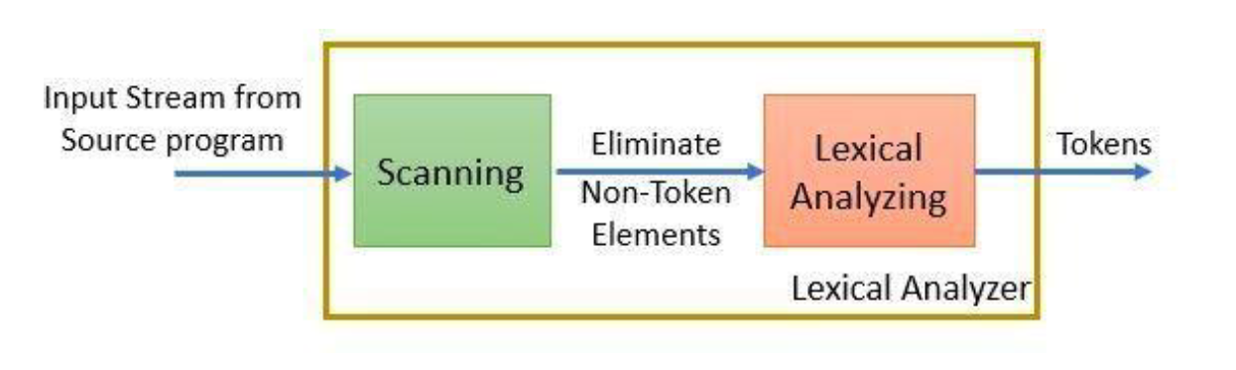
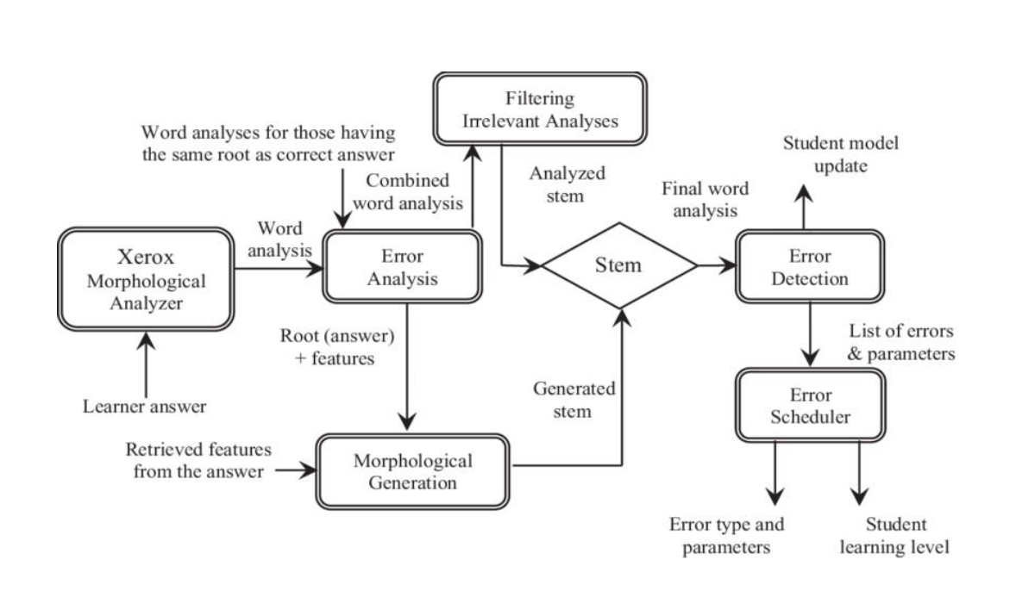
ARCHITECTURE DIAGRAM OF LEXICAL ANALYZER

Slide 8
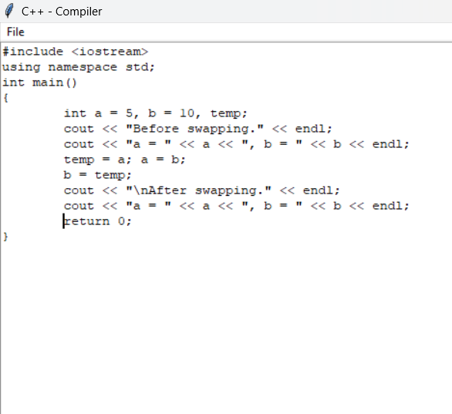
Implementation
INPUT FILE

Slide 9
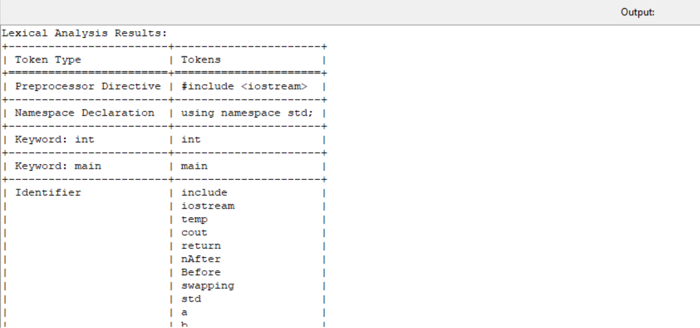
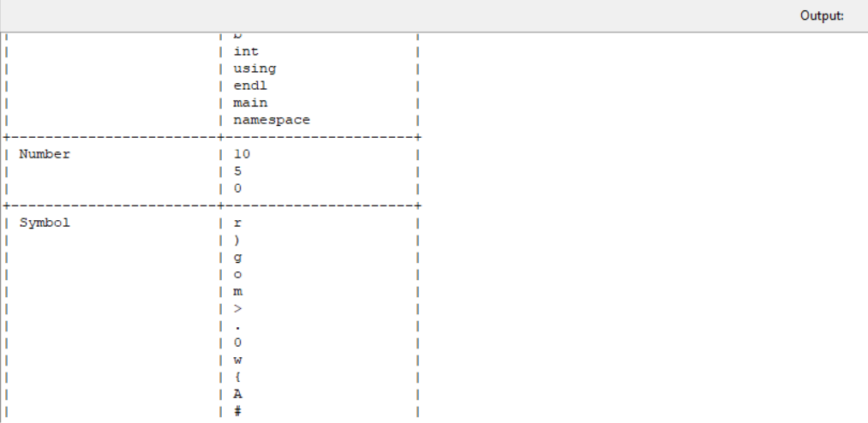
Implementation
LEXICAL ANALYZER

Slide 10

Conclusion
The compiler incorporates different phases of the compilation process, providing a comprehensive solution for translating high-level programming languages into executable machine code.
The graphical user interface enhances the user experience by providing an intuitive and interactive platform. The GUI allows users to conveniently write and edit their code, view the compilation process step-by-step, and examine the generated output. Error reporting and diagnostics are integrated into the interface, ensuring a seamless development experience
The compilation process is seamless, with lexical analysis generating a token stream, and syntax analysis constructing a parse tree.
The project has developed a Python-based compiler with Tkinter, showcasing the practical application of compiler construction principles.

Slide 11
Reference
Compilers–Principles, Techniques and Tools By Alfred V. Aho, Monica S. Lam, Ravi Sethi, Jeffrey D. Ullman
https://www.geeksforgeeks.org/intermediate-code-generation-in-compiler-design/
http://web.cs.wpi.edu/~kal/courses/compilers/
https://www.tutorialspoint.com/compiler_design/compiler_design_intermediate_c ode_generations.html

